Slide 1


Universal Service Obligation – Financial Inclusion – India Post
Digital Transformation, Logistics & Inclusion (2025–26)

Slide 2
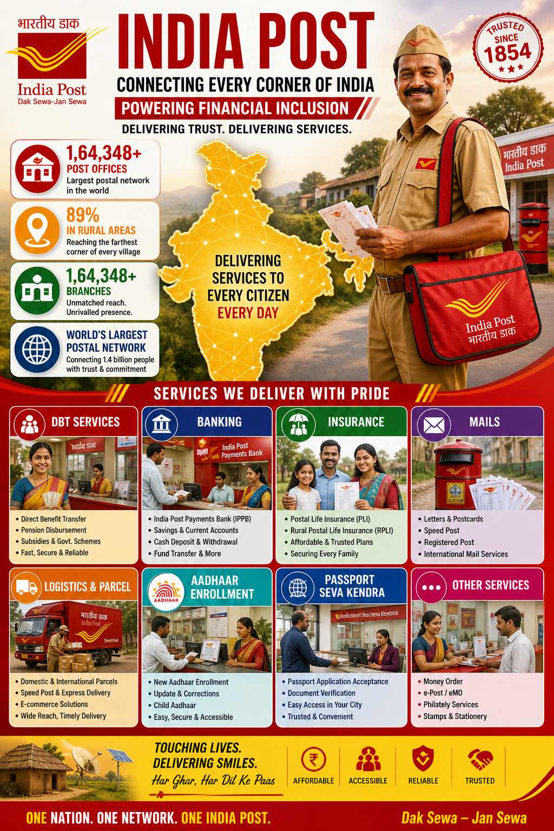
Overview
• 1.65 lakh post offices (90% rural)
• Backbone of financial inclusion
• Transition: Mail → Logistics + Banking

Slide 3
Financial Performance
• Revenue: ₹15,296 crores
• Growth: ~16%
• Drivers: Parcels, Banking, DBT

Slide 4
Mail vs Parcel Trend

Slide 5
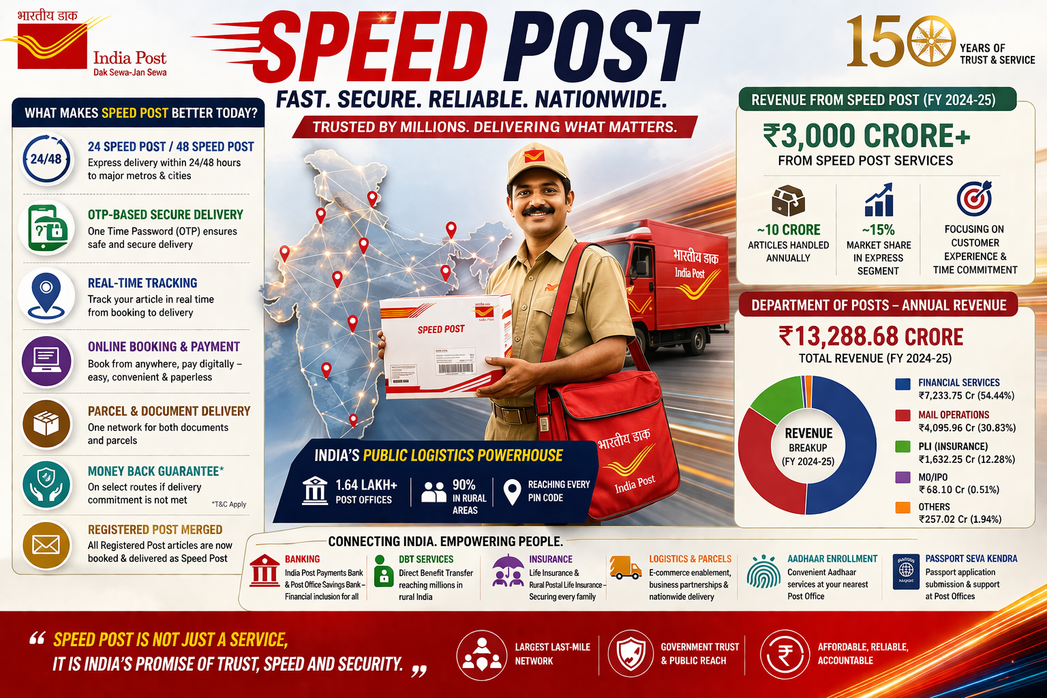
Speed Post
Growth driven by trust, reach & govt usage

Slide 6
Logistics Expansion
NDCs, E-commerce, Real-time tracking

Slide 7
Competition
India Post: Reach & Trust
Private: Speed & Tech

Slide 8
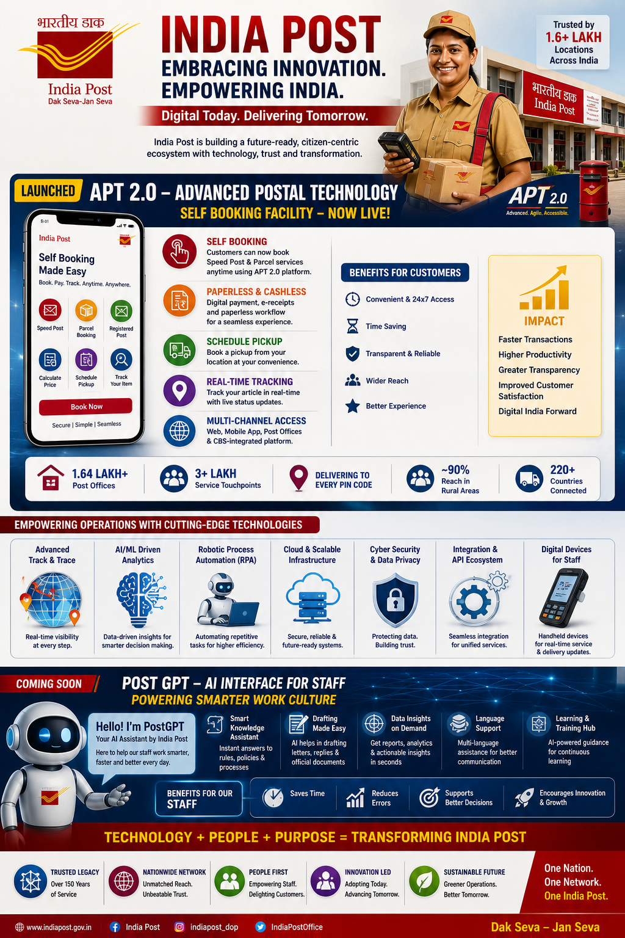
Digital Transformation
IT 2.0, RFID, Online booking

Slide 9
IPPB
Financial inclusion, DBT, rural reach

Slide 10
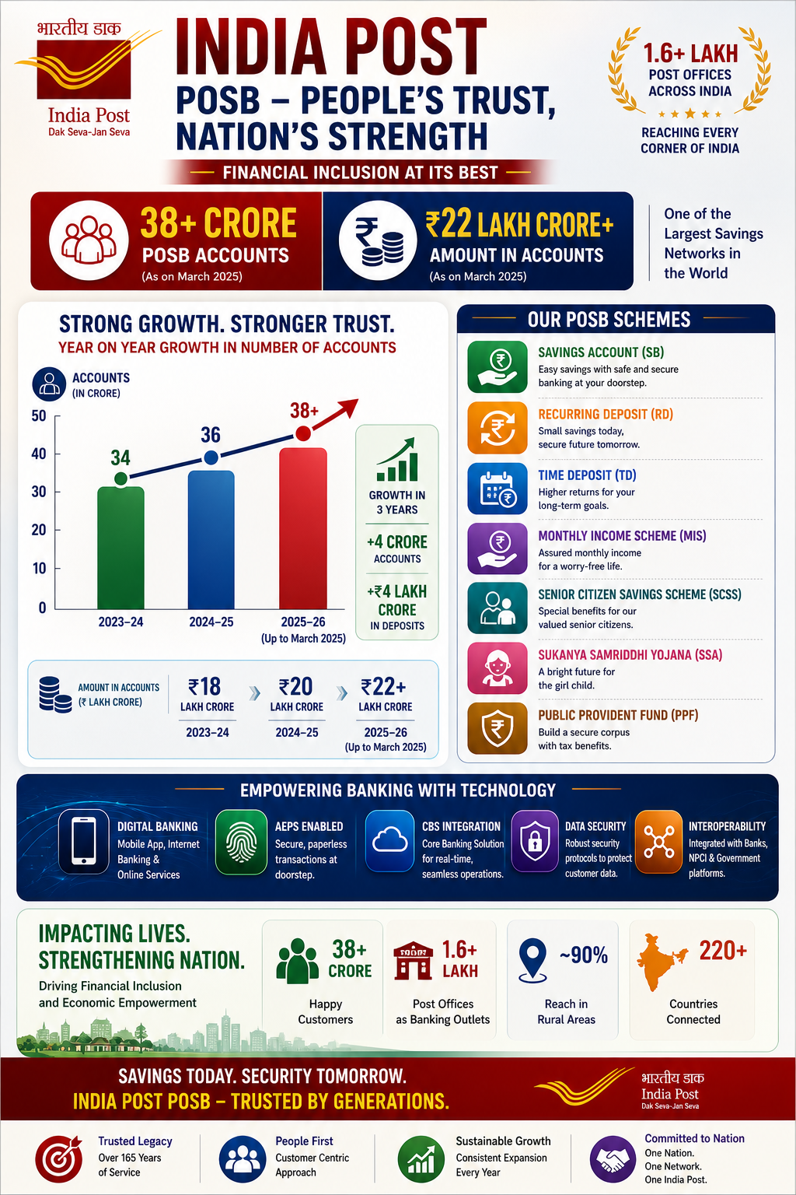
POSB
Trusted savings system for rural India

Slide 11
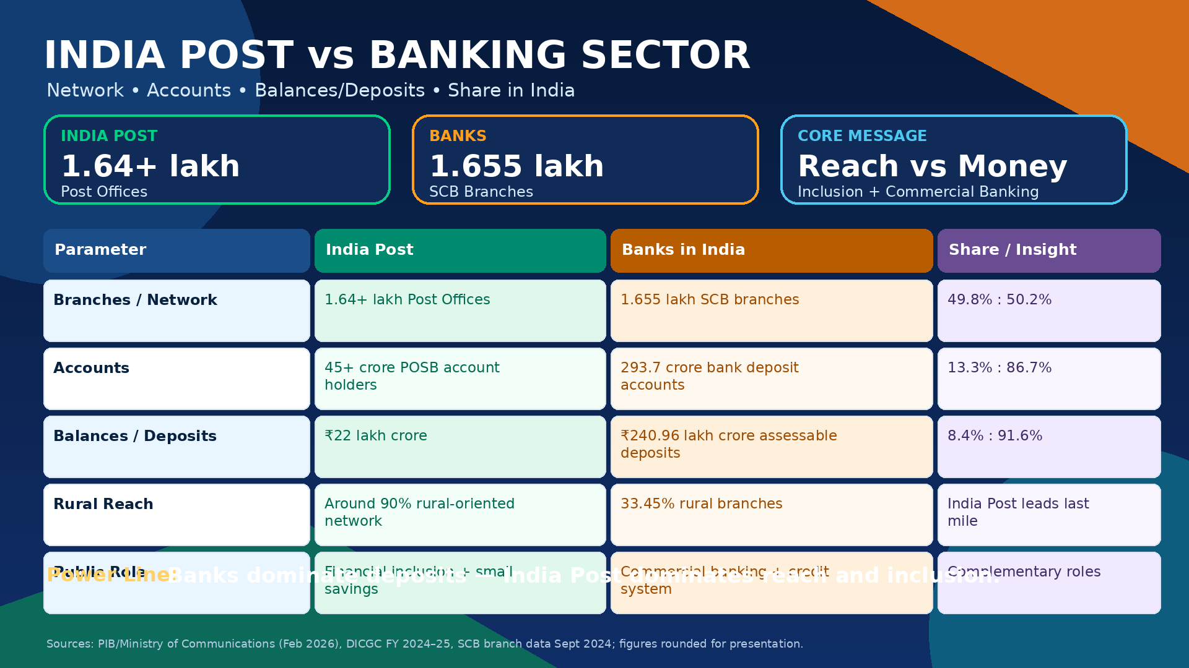
Bank Comparison
IPPB/POSB vs Public & Private banks

Slide 12
USO Strength
Network + Trust + Integration

Slide 13
Global Comparison
USPS, Royal Mail, China Post vs India Post

Slide 14
Challenges
Competition, mail decline, modernization

Slide 15
Conclusion
India Post = Inclusive, Reliable, Universal

